Slide 1
Pokémon: A Comprehensive Overview
Generated Presentation

Slide 2

Slide
Title: Pokémon: A Comprehensive Overview

Slide 3
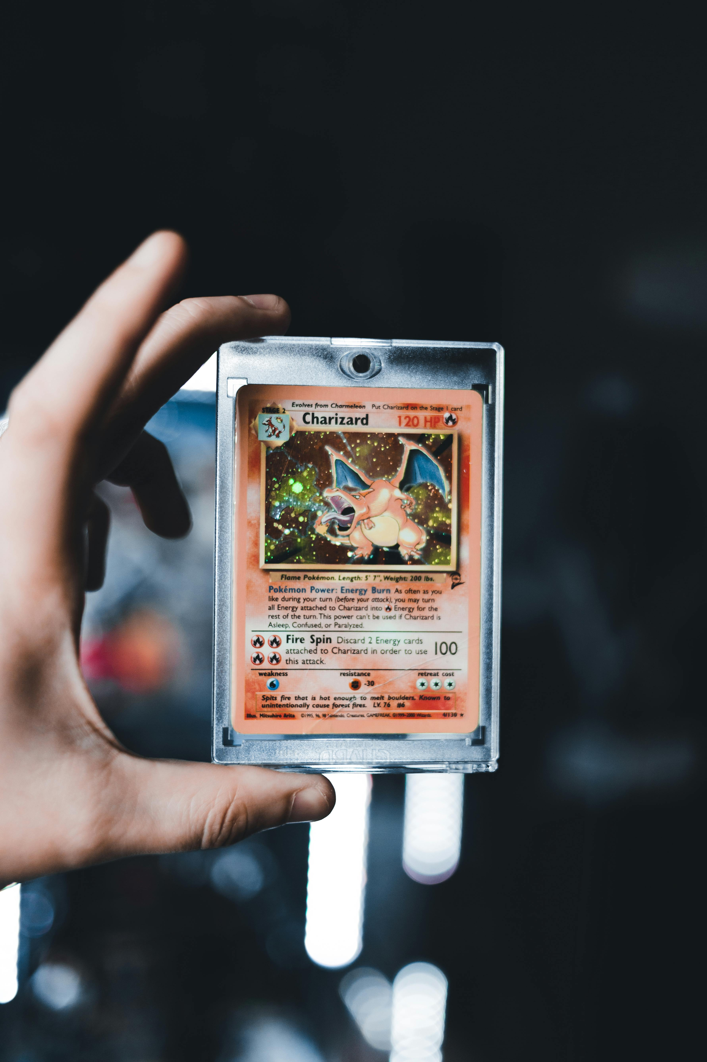
Origins of Pokémon
Franchise origin: 1996, *Pokémon Red and Green* for Game Boy.
Developed by Game Freak, creatures with unique abilities.
Initial concept: World inhabited by collectible monsters.
Key Founders: Nintendo, Game Freak, and Creatures.

Slide 4

Core Gameplay Loop
Train Pokémon: Battle wild Pokémon and other trainers.
Increase strength and level through battles.
Evolution: Pokémon transform into more powerful forms.
Gameplay loop: Training, battling, evolving, and collecting.

Slide 5

Elemental Types
Type system: Fire, Water, Grass, Electric, Psychic, etc.
Pokémon possess one or two elemental types.
Type matchups: Strengths and weaknesses (rock-paper-scissors).
Strategic depth: Type effectiveness crucial for battle.

Slide 6
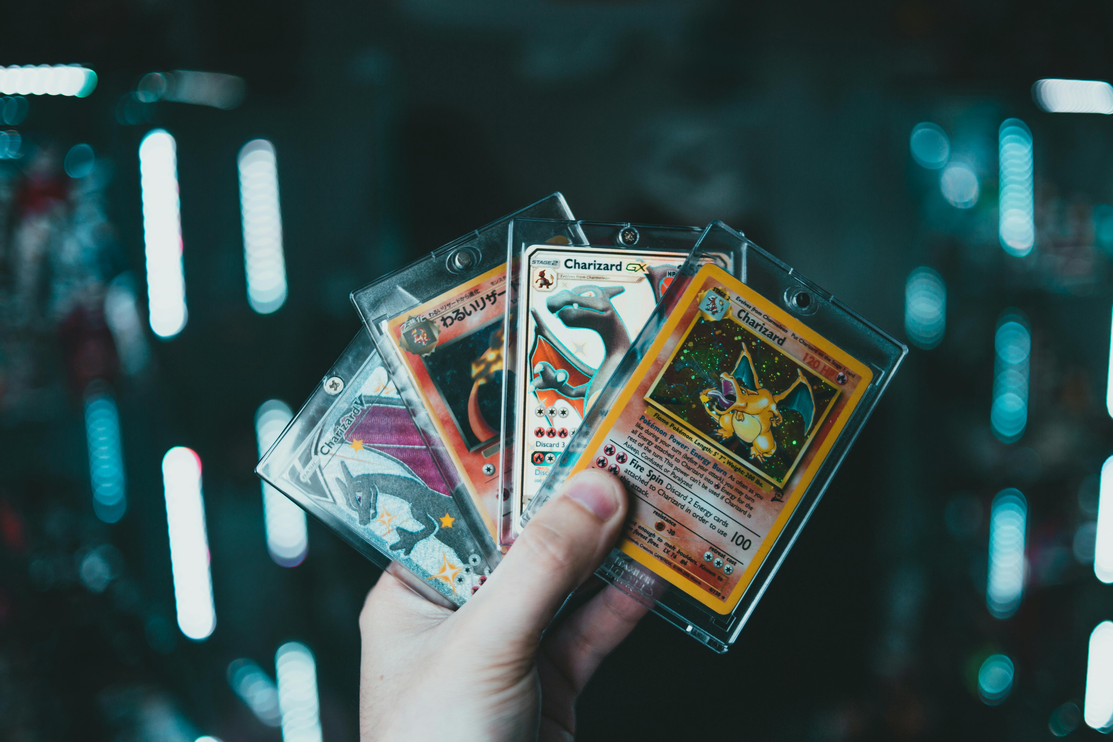
Anime Adaptation
Anime launch: 1997, widespread popularity surge.
Protagonist: Ash Ketchum (Satoshi) and Pikachu.
Journey: Travel the world, collect Pokémon.
Goal: Compete in the Pokémon League.

Slide 7

Trading Card Game (TCG)
Expansion: TCG further expanded the Pokémon universe.
Strategic deck-building: Construct powerful card combinations.
Competitive play: Tournament scenes and online matches.
Strategic Gameplay: Adding another layer to the experience.

Slide 8

Pokémon Go Phenomenon
Release year: 2016, global sensation.
Augmented Reality (AR): Catch Pokémon in the real world.
Mobile devices: Accessible gameplay on smartphones.
Broadened reach: Attracted new audiences to the franchise.

Slide 9
Franchise Management and Appeal
The Pokémon Company: Oversees all aspects of the franchise.
Diverse media: Video games, anime, manga, merchandise.
Enduring appeal: Strategic gameplay, compelling world.
Key factors: Collectibility, friendship, overcoming challenges.
Continuous evolution: New regions, mechanics, and features.

